Slide 1
Photo Editing Web and Mobile Applications
Ali Ahmad Khan (218598)
Muhammad Sarosh Tahir (219088)
Nayyara Naseer (233606)
Osama Akhlaq (213452)
Safa Sadiq (237643)

Slide 2
Contents
Problem Statement
Proposal
Tools and Programming Languages
Innovation
Work Division
Incomplete features
Implementation
Output
Limitations
Future Development
Components

Slide 3
Problem Statement
We chose a basic photo editing web application which applies the standard red-green-blue (RGB) filter to the pictures.
However, this offered limited functionality and did not provide the feature to edit our own images.

Slide 4
Proposal
Enhancing an already-developed photo editing web application by introducing:
Advanced filters
Option to capture a live image
Developing a photo editing Android application.

Slide 5
Tools & Programming Language
Node – this will be used for the back-end of the application,
Node Package Manager (NPM) – to install various modules offered by Node,
React – for the front-end of the application,
React Native – for the development of a mobile application for the photo editor,
JSX – some features will be implemented through this language, particularly those related to the processing of the images.

Slide 6
Innovation
Advanced Filters in the web application:
Brightness
Black and White Filter
Negate
Border
Cartoonify
Vigenette
Tint
Oil Painting
Outline
Vibrance
Option to capture a live image to use in editing

Slide 7
Innovation
The (Android) mobile application was made with the following features in it:
Option to capture an image
Save an image to the gallery
Use an image from the gallery to edit it
Crop a picture
Flip a picture vertically and horizontally
Resize a picture
Zoom a picture

Slide 8
Libraries/Components
The following are the most important libraries/components used in our codes.
cloudinary-react
Allows using the advanced filters of cloudinary library
expo-camera and react-native-camera
Allows using camera features of the phone while working with expo
react-webcam
Allows using the web-camera features of the user system

Slide 9
Implementation
Advanced filters:
createAdvanceEffects(type) {
let transforms = this.state.transforms;
switch(type) {
case "cartoon":
const transform = {
key: "cartoonify",
value: "20:60"
}
transforms = this.getUpdatedTransform(transforms, transform);
break;
case "vignette":
const transform_v = {
key: "vignette",
value: "30"
}
transforms = this.getUpdatedTransform(transforms, transform_v);
break;
case "oil_painting":
const transform_p = {
key: "oil_paint",
value: "40"
}
transforms = this.getUpdatedTransform(transforms, transform_p);
break;

Slide 10
Implementation
Live-capturing an image:
captureImage() {
this.props.saveCapturedImage(this.refs.webcam.getScreenshot());
}
render() {
return (
<div>
<Grid container spacing={1}>
<Grid item xs={12}>
<Webcam
ref="webcam"
audio={false}
// height={350}
screenshotFormat="image/jpeg"
// width={350}
videoConstraints={this.state.videoConstants}
/>
</Grid>
<Grid item xs={12}>
<Button variant="contained" align="center" color="primary" onClick={() => this.captureImage()} >
Capture
</Button>
</Grid>
</Grid>
</div>
)
}

Slide 11
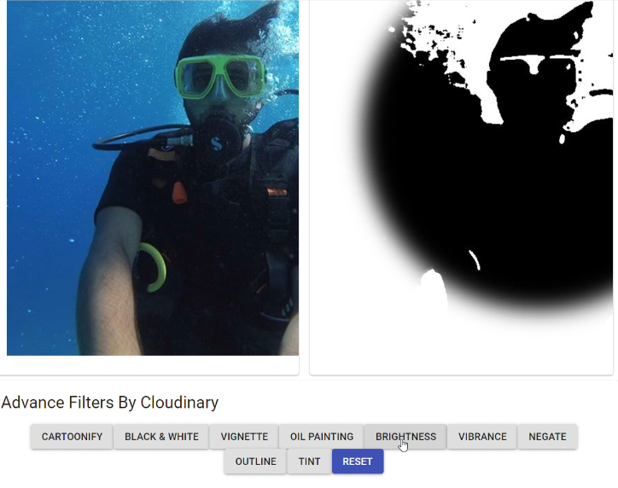
Output (i)
Advanced Filters

Slide 12
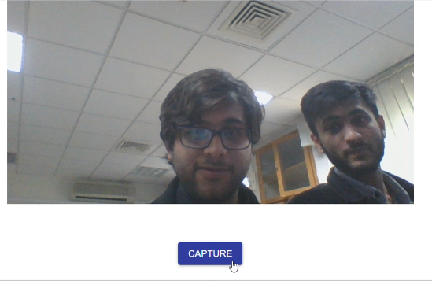
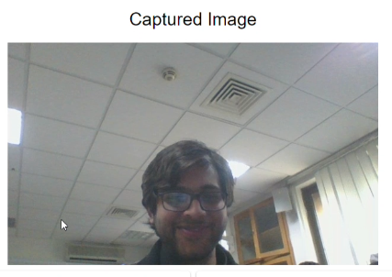
Output (ii)
Live-capturing an image

Slide 13
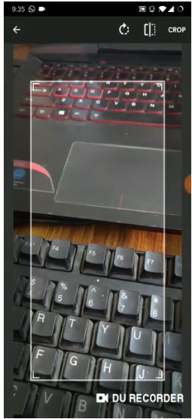
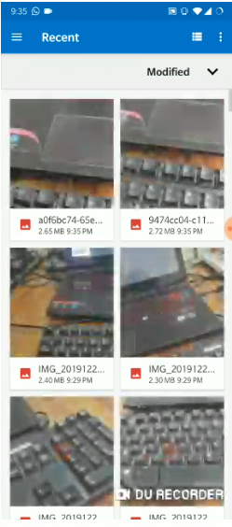
Output (iii)
Cropping a picture and accessing gallery in the mobile application

Slide 14
Work Division
Adding enhanced features to the web-based application:
Nayyara Naseer
Osama Akhlaq
Muhammad Sarosh Tahir
Developing the mobile-based application:
Safa Sadiq
Ali Ahmad Khan
Muhammad Sarosh Tahir

Slide 15
Incomplete Features
We tried to integrate the following features in our project. However, they are incomplete and do not run successfully.
Web-based Application:
Use the live-captured image to apply the filters and effects on
Mobile-based Application:
Apply filters to the captured image

Slide 16
Limitations
Currently, there is no feature in the web-based application to save the edited photos to the local storage.
A single, already-set picture can be edited rather than an image of the user’s choice.
The mobile application does not provide any filters to apply on the pictures.
The live-captured image cannot be applied filters to in the web-based application.

Slide 17
Future Development
Filters can be added to the pictures being captured and edited in the mobile application.
The pictures being edited in the web application can be saved to the local storage.
Live-captured pictures can be edited.
User accounts can be created to allow a person to save their edited pictures in their account.

Slide 18
NOTE
Since our compressed file is exceeding the allowable limit on LMS, we are unable to upload it there. Therefore, we have just uploaded the presentation.
Our entire project can be found at the following GitHub profile:
https://github.com/NayyaraNaseer

